Slide 1
HNDIT1101: Personal Computer Applications
Week 02 -

Slide 2
Basic features in MS Word processing software
Week 2

Slide 3
Word Processing
Software that is designed for the entry, editing, and printing of documents.
Eg:
  Letters
  Faxes
  Reports
  One page flyers
  Email
  Memorandums
Notes:
A flyer is a form of paper advertisement intended for wide distribution and typically posted or ... Advertise an event such as a music concert, nightclub appearance, festival,

Slide 4
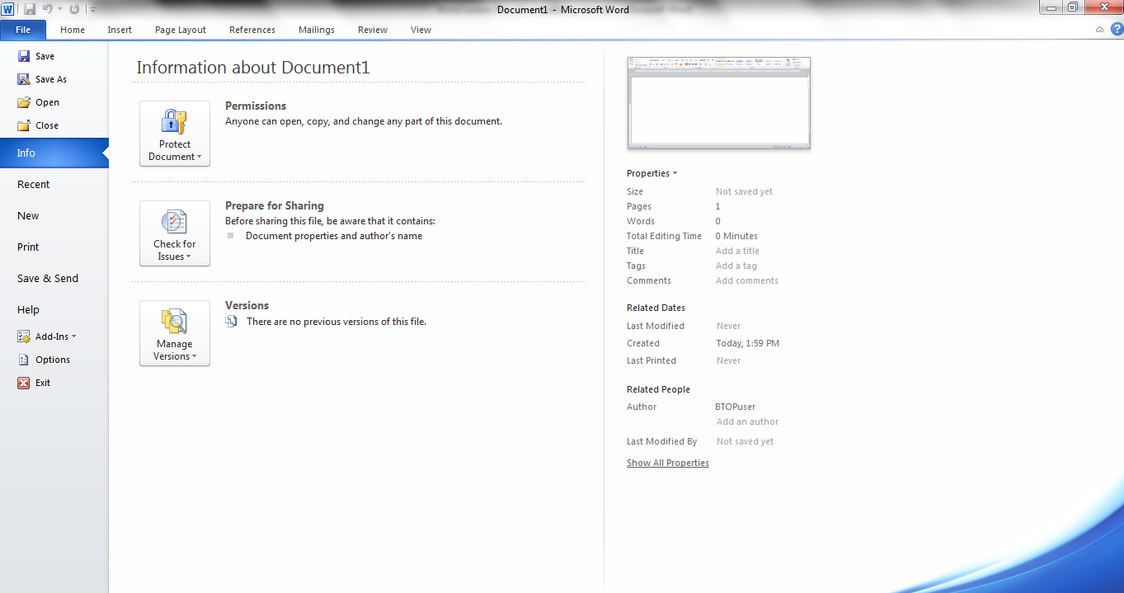
Tabs
      File:The File Tab menu contains the commands most commonly associated with the file.
        New
        Save
        Save as
        Print
        share

Slide 5
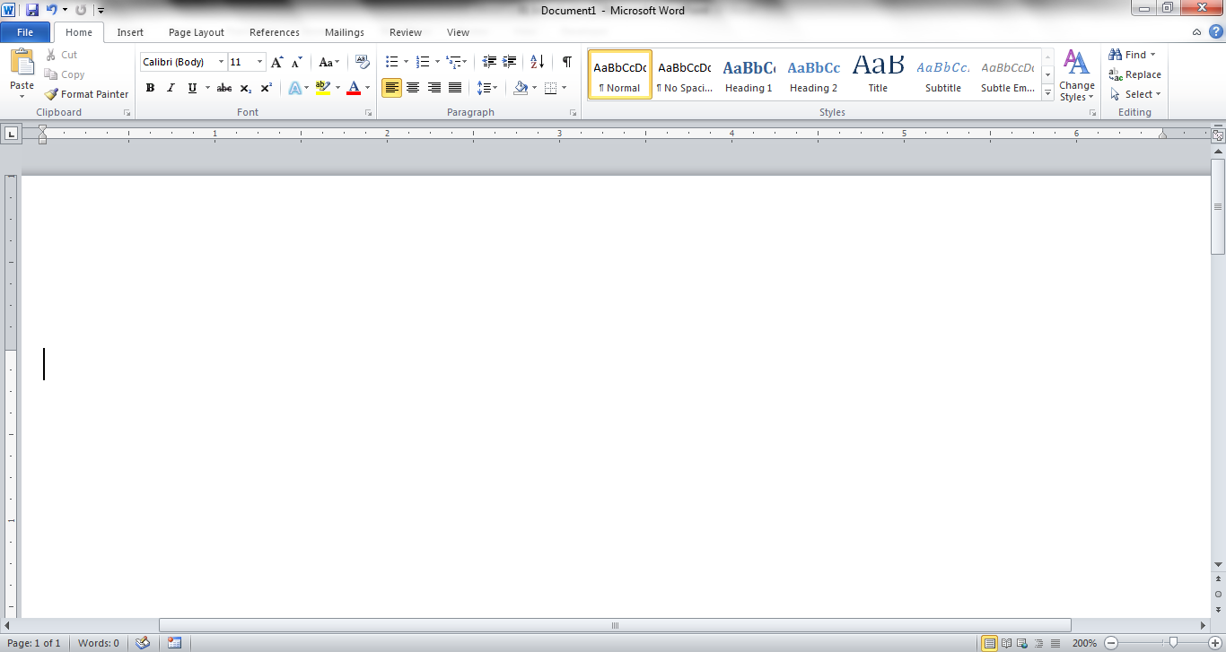
Home Tab
.
It is contain the commands most commonly associated with the formatting and editing of text
  Clipboard
  Fonts
  Paragraphs
  Styles
  Editing
Notes:
Clipboard-see all the item you have copied to the clipboard
Fonts – help to customized your text
Paragraphs- fine-tune the layout of the current paragraphs
Styles-customized the text styles in word
Editing – editing options are there

Slide 6
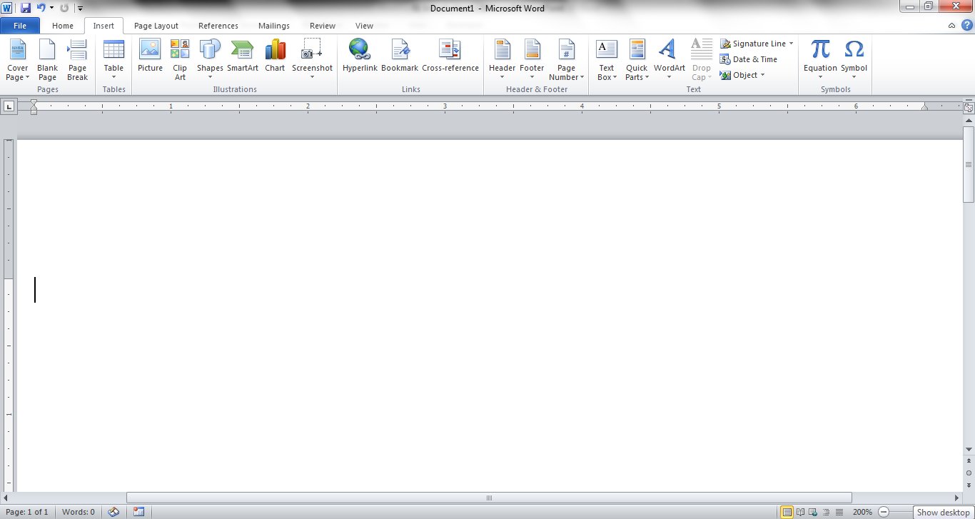
Insert Tab
It is contain the commands associated with adding something to the document.
Pages Tables
Illustrations Links
Header & Footer Text
Symbols

Slide 7
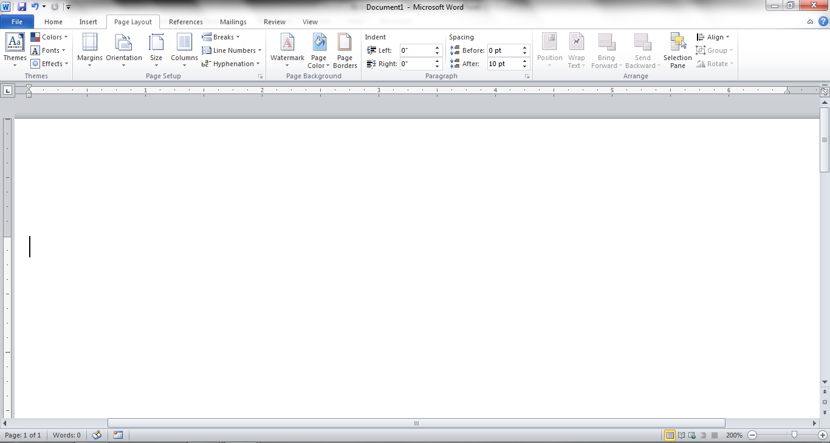
Page Layout
It contains the commands associated with settings that would affect the entire page or document.
Themes
Page Background
Page Setup
Paragraph
Arrange

Slide 8
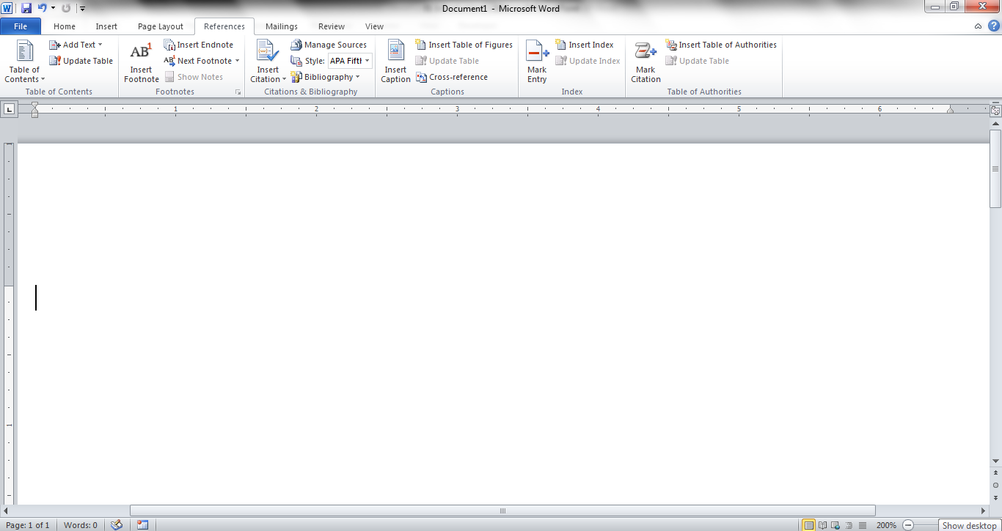
References
It contains the commands associated with writing a research paper, essay, term paper or similarly formal documents.
Table of Contents
Captions
Footnotes
Index
Citations & Bibliography
Table of Authorities

Slide 9
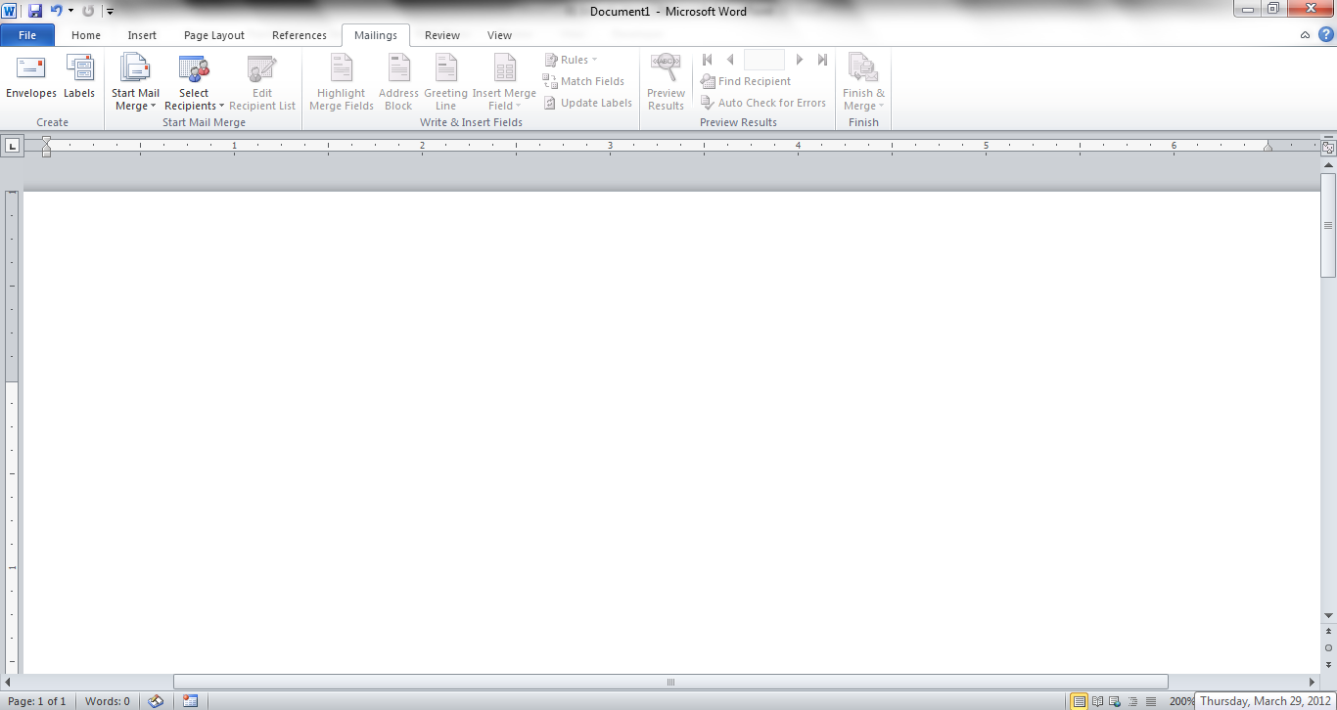
Mailings Tab
It contains the commands most commonly associated with documents and files created for mass mailing.
Create
Write & Insert Fields
Start Mail Merge
Preview Results
Finish

Slide 10
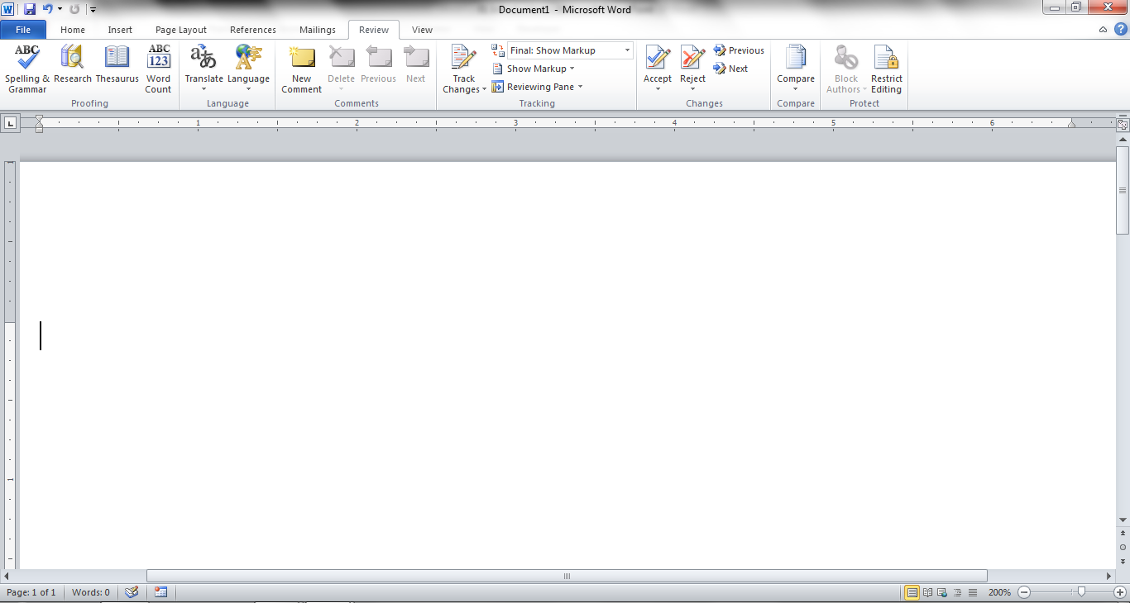
Review Tabs
It contains the commands associated with documents which are shared or being prepared for publication.
Proofing
Changes
Language
Compare
Comments
Protect
Tracking

Slide 11
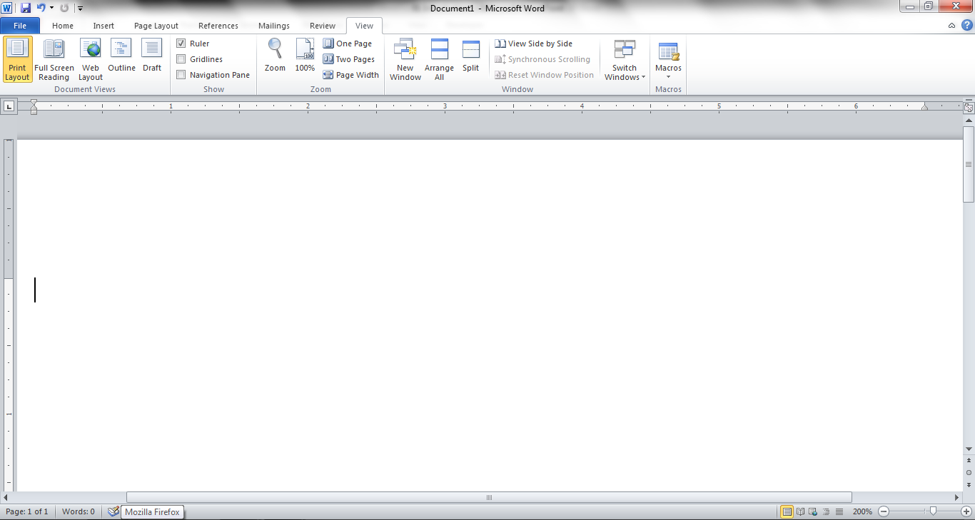
View Tab
It contains the commands associated with the variety of ways you can “look at” a document or documents.
Document Views
Show
Zoom
Window
Macros

Slide 12
END

